Slide 1
Transformational Medicines for Neurological & Psychiatric Disorders
CORPORATE OVERVIEW

Slide 2
Ceruvia Lifesciences researches, develops, and manufactures neurotransformational medicines to deliver meaningful relief to patients suffering from challenging, hard-to-treat headache and psychiatric disorders
Transforming psychedelic research into cutting-edge medicine
2
Developing two novel compounds across numerous therapeutic areas
BOL-148 in Headache and Addiction Disorders
Psilocybin in Headache and Obsessive-Compulsive Disorder
10
Over ten years of funding and coordinating academic research in neurotransformational and psychedelic medicine
Involvement with leading research and development institutes in psychedelic medicine
Development programs in partnership with leading medical centers
150
Life sciences expertise that delivers scientific rigor
Expert technical team with over 150 years industry experience
Scientific advisors from leading research institutes across USA and Europe

Slide 3
Our strategic focus is on realizing the value of our pipeline assets
Fund
Provide Evidence
Advance
Commercialize
Position ourselves as therapeutic leaders by targeting funding into difficult-to-treat disease areas with great unmet need
Generate robust scientific clinical data from controlled clinical trials with innovative collaborators, partners, academia and industry experts to progress the projects
As the world's first manufacturer of GMP LSD and GMP BOL-148, we adhere to the highest development, testing, and manufacturing standards as established by regulatory authorities as well as pharmaceutical industry associations and organizations
Ceruvia Lifesciences aims to ultimately deploy treatments to create a significant benefit for all stakeholders in our focus areas: patients, caregivers, payers, and healthcare providers

Slide 4
Over a decade of driving clinical research and progress in nuerotransformational medicines
BOL-148 project transferred to stand-alone entity for further development
Ceruvia Lifesciences becomes the official name of CH-TAC
Ceruvia Lifesciences becomes world’s first manufacturer of
GMP LSD, which we supply free of cost to academic research sites
GMP BOL-148
C. Turnbull joins Board of Directors, currently President
BOL-148 patents licensed to new entity, partial ownership with C Turnbull
Non-profit formed to develop Psilocybin for addictive disorders
C. Turnbull joins NYU Psychedelic Research Group Advisory Board; Principal Funder of research using psilocybin to treat depression and addiction
C. Turnbull helps establish and funds Psilocybin research program
Establish closely held company to develop BOL-148
C. Turnbull joins Board of Directors
2010 2011 2012 2013 2014 2015 2016 2017 2018 2019 2020 2021 2022
Since 2010, Carey Turnbull has contributed as a fundraiser and individual donor over $29 MM to Psychedelic Research

Slide 5
Our Development Pipeline
DISCOVERY
PRE-CLINICAL
PHASE 1
PHASE 2A
PHASE 2b/3
NDA
MIGRAINE
CLUSTER HEADACHE
NYPRG-101 (BOL-148)
OPIOID USE DISORDER
ALCOHOL USE DISORDER
CLINICAL PROGRAM
MIGRAINE
SYNP-101 (Synthetic Psilocybin)
CLUSTER HEADACHE
OBSESSIVE COMPULSIVE DISORDER

Slide 6
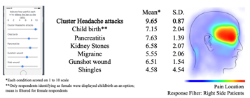
Significant burden and unmet needs in the markets we aim to address
Headache Disorders
Psychiatric Disorders
~40mm
330k
3.9mm
Migraine Patients USA¹
Cluster Headache Patients USA²
Obsessive Compulsive Disorder Patients USA¹
More Than Just A Headache
More Painful Than Childbirth or Gunshot Wounds⁴
OCD significantly impacts patients’ ability to live normal lives
$36b
79.9%
Est. Annual Direct/ Indirect Costs of Migraine (USA)³
Severe OCD patients
reported severe role impairment (SDS scale)²
SOURCE:
https://migraineresearchfoundation.org/about-migraine/migraine-facts/
https://www.nimh.nih.gov/health/statistics/obsessive-compulsive-disorder-ocd
Bonafede et al, Headache 2018
Source: Schor et al, CHQ Poster, www.Clusterbusters.org, 2017
SOURCE:
https://www.nimh.nih.gov/health/statistics/obsessive-compulsive-disorder-ocd
Source: Ruscio et al, Molecular Psychiatry 2010

Slide 7
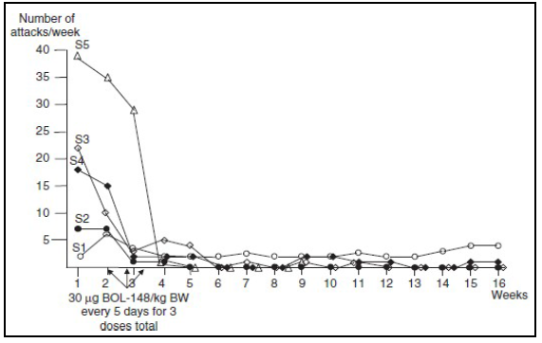
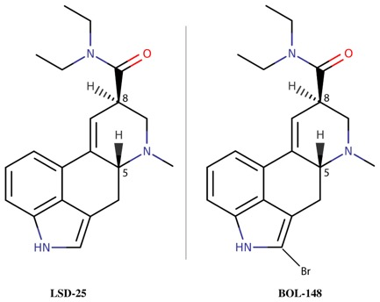
NYPRG-101: Promising efficacy without hallucinogenic effects
Pilot Study in Patients with Cluster Headache
NYPRG-101 (BOL-148) is a non-hallucinogenic analog of LSD used in the past as a placebo
Results from a pilot study in Cluster Headache suggest long-term efficacy following brief treatment
Safely administered pre-clinically & clinically to ~300 humans
Open-label, uncontrolled study at Harvard/ Hannover
5 BOL-148 subjects, 3 oral doses over 10 days
100% patients reported significant relief of CH symptoms

Slide 8
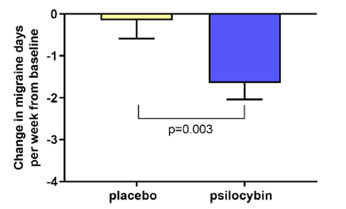
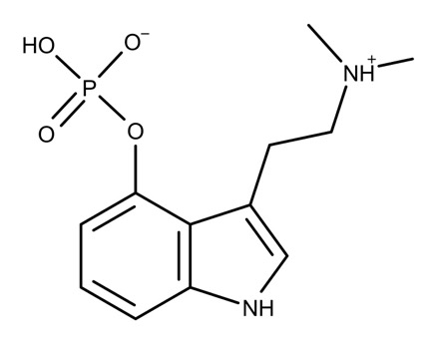
SYNP-101: Building on promising research at leading universities
Exploratory study suggests there is an enduring therapeutic effect in migraine headache after a single administration of psilocybin. Schindler et al, Neurotherapeutics (2020)
SYNP-101 is a synthetic form of the naturally occurring compound, psilocybin, found in at least 200 species of mushrooms
For over a decade, thousands of cluster headache sufferers have self-medicated using psilocybin with exceptional results
Psilocybin has been shown to be safe when administered in a therapeutic setting
3 of 5 OCD patients randomized to receive psilocybin exhibited robust reductions in acute Yale-Brown Obsessive-Compulsive scores (Y-BOCS)” Kelmendi et al. Examining the Effect of Psilocybin in the Treatment of Treatment-Resistant OCD Poster ANCP (2020)
Based on interviews with researchers, 22 of 26 patients with cluster headache reported that psilocybin aborted attacks and 18 of 19 reported remission period extension. Sewell et al, Neurology (2006)

Slide 9
Ceruvia Lifesciences has established collaborations with leading institutions and stakeholders

Slide 10
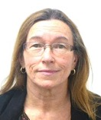
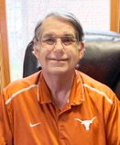
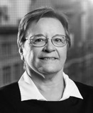
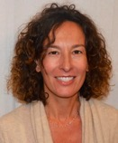
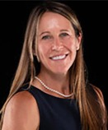
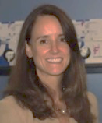
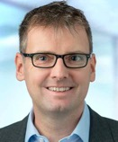
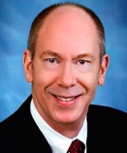
Experience that knows how to deliver value
Carey Turnbull
FOUNDER / CEO
10+ years Investment/ Philanthropy in Psychedelic Medicine
Kathleen Monroe
Shayne Gad, PhD, DABT
COO
Pharmacology & Toxicology
20+ years Pharmaceutical Project Management
40+ years Toxicology & Pharmacology
Ryan Lanier, PhD
Clinical Scientist
20+ years Pre-Clinical & Clinical Development of CNS Drugs
Judy Ashworth, MD
Eric Galia
Clinical & Regulatory Strategy
Project Lead
20+ years Analgesic & CNS Drug Development
20+ years CMC Development & Pharmaceutical Project Management
Stephan Loose, MBA
Business Development
15+ years Pharmaceutical Commercialization & Business Development
Jeanne Bonelle
Sophie Goubet Sieradzki
CMC, QA
Clinical Research Associate (OCD)
Amy Poshusta, PhD
40+ years in Quality Assurance and CMC development
20+ years Clinical Research
Non-clinical Development
20+ years Pharmaceutical Drug Development
Judy Carmody, PhD
Tom Huijbers
QA
Regulatory Affairs, R&D
John Wetzel, PhD
25+ years Quality Assurance GMP
20+ years Regulatory Pharmaceutical Strategist
CMC
30+ years Pharmaceutical Drug Development & CMC

Slide 11
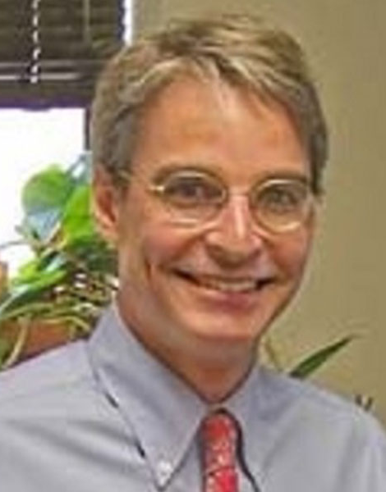
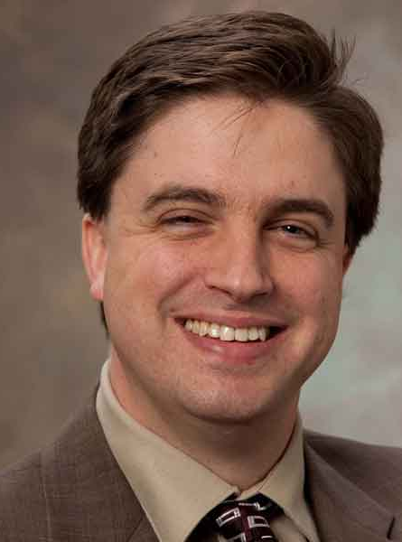
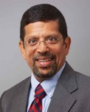
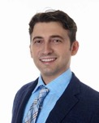
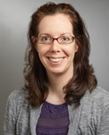
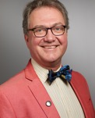
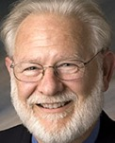
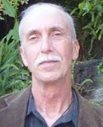
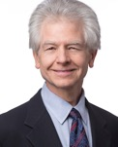
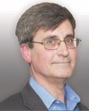
Leading experts as part of the Scientific Advisory
Michael Bogenschutz, MD
Bob Jesse
Chris Pittenger, MD, PhD, FAPA, FANA
NYU Langone’s Department of Psychiatry
Advisor
Professor, Department of Psychiatry at NYU Grossman School of Medicine, Addiction & Social Anxiety Disorders
Founder, Council on Spiritual Practices
Yale University School of Medicine
Professor of Psychiatry
Assistant Chair for Translational Research, Psychiatry
Director, Yale OCD Research Clinic
Director, Neuroscience Research Training Program, Yale Department of Psychiatry
Deepak D’Souza, MBBS, MD
Ben Kelmendi, MD
Emmanuelle Schindler, MD, PhD
Yale University School of Medicine
Yale University School of Medicine
Yale University School of Medicine
Clinical Director & Psychiatrist at VA Connecticut Healthcare System
Director, VA-Yale Schizophrenia Research Fellowship program
Director, Schizophrenia Neuropharmacology Research Group at Yale (SNRGY)
Assistant Professor of Psychiatry, Yale University School of Medicine
Assistant Professor of Neurology, Yale School of Medicine
Medical Director, Headache Center of Excellence, VA Connecticut Healthcare System
Christoph Gottschalk, MD, FAHS
David Nichols, PhD
Bob Wold
Yale University School of Medicine
UNC Eschelman School of Pharmacy
Cluster Busters
Assistant Professor of Clinical Neurology
Chief, Division of General Neurology, Neurology
Director, Fellowship Program, Headache & Facial Pain Center
Adjunct Professor UNC Eshelman School of Pharmacy
Founding President Heffter Research Institute
Founder and President – Clusterbusters, Inc.
Board of Directors – AHDA (Alliance for Headache Disorder Advocacy)
Jack Henningfield, PhD
Torsten Passie, PhD
William Young, MD
Regulatory Strategy
Hannover Medical School
Jefferson University Hospital
Vice President, Research, Health Policy, and Abuse Liability, Pinney Associates
Adjunct Professor, Behavioral Biology, Medical School’s Department of Psychiatry and Behavioral Sciences
Professor of Psychiatry and Psychotherapy – Hannover Medical School, Germany
Visiting Professor (2012-2015) – Harvard Medical School, MA, USA
Professor of Neurology and Co-Director Inpatient Program, Jefferson University Hospital
Founder, Physician & Advisor Coalition for Headache and Migraine Patients (CHAMP)

Slide 12
DIFFERENTIATED
All compounds in the portfolio have the potential to be clearly differentiated from current standard of care in conditions with significant unmet needs
SIGNIFICANT
Significant unmet needs with a substantial disease burden means significant benefit can be brought to patients
Ceruvia Lifesciences represents a unique opportunity to make a significant impact
PROMISING
Promising real-world and clinical data support a truly differentiated efficacy profile with good safety and tolerability
SUPPORTED
Modes of action support efficacy in other indications for product life-cycle management
REWARDING
Robust data and going concern status support commercial returns
We believe patients suffering from debilitating headache disorders and difficult-to-treat psychiatric disorders, like OCD, no longer have to live this way.

Slide 13
Transformational Medicines for Neurological & Psychiatric Disorders
www.ceruvialifesciences.com
investors@ceruvialifesciences.com

